Slide 1

Covid – 19
Rice university Data analytics bootcamP
Who will suffer the most ?
Group 1 - Project 1
Norman Gwinn | Panarat Duke | Michael Heitmann | Gini Arimbi

Slide 2
Table of contents
Introduction
Objective and main question
Project Methodology
Output
Conclusion
Limitation and Recommendation

Slide 3
Background
Multiple pandemics in the past (Spanish Flu, Asian Flu, Swine Flu SARS)
Number of new cases throughout the world
Different health care facility
To check the health care preparedness for US states
Introduction
Project Methodology
Conclusion
Main Question and Project Objectives
Output
Limitation and Recommendation
Notes:
-The world has experience multiple pandemics throughout its history. The recent one is COVID 19
-Starting of early this year, it started in Wuhan and China. 3 months later, no one have predicted that it reaches almost all countries
-Every country is affected, but every country has different preparedness for this pandemic. One of the most crucial criteria is the healthcare facility
-That’s why our group want to investigate which states in US will be most vulnerable

Slide 4
Project objectives
“Which US states will be the most vulnerable in facing Corona virus cases?”
To obtain growth rate for cases in global, selected countries, and US
Using linear and exponential plot
Comparing the growth rate to availability of health facility (hospital bed per 1000 person)
Using heat map and bubble map
Find correlation between infection cases with population density
Using scatter plot and linear regression
Introduction
Project Methodology
Conclusion
Main Question and Project Objectives
Output
Limitation and Recommendation

Slide 5
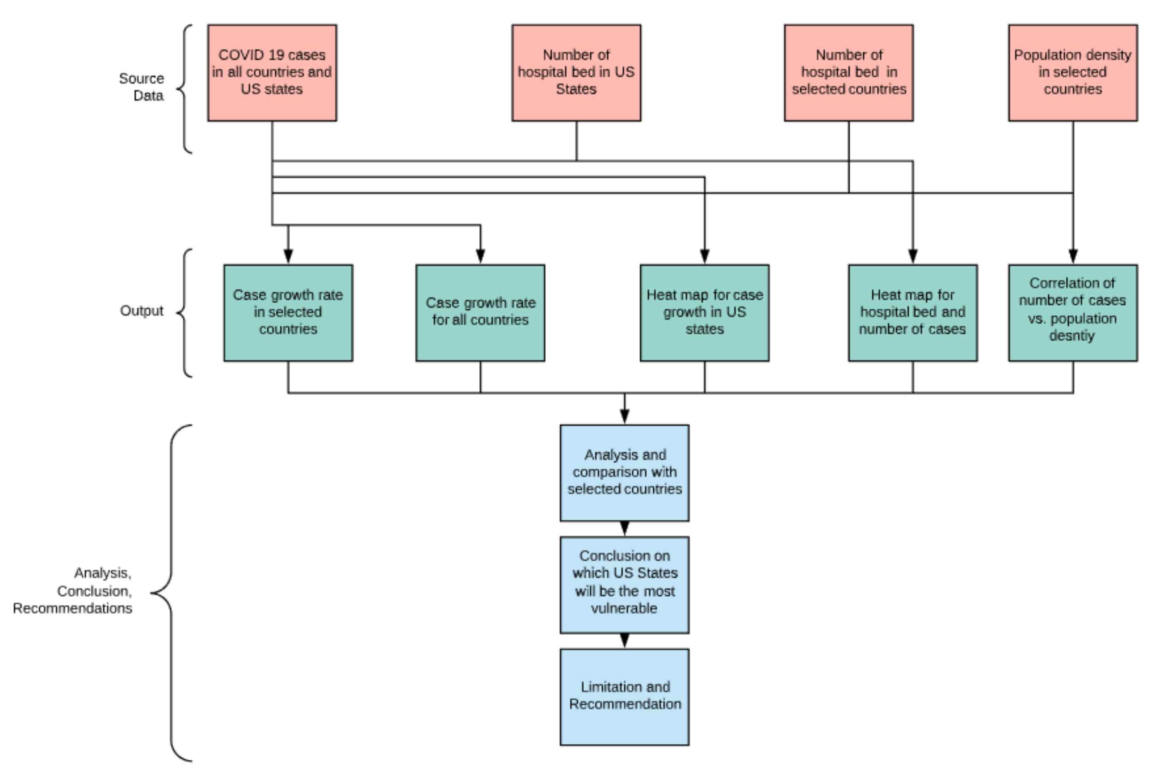
Project Methodology
Introduction
Project Methodology
Conclusion
Main Question and Project Objectives
Output
Limitation and Recommendation
Notes:
-We use source data from worldometer, World Bank, John Hopkins University
-From this data source, we use to plot several graphs to see different relationships and to predict the growth rate
-From there, we derive our analysis and conclusion

Slide 6
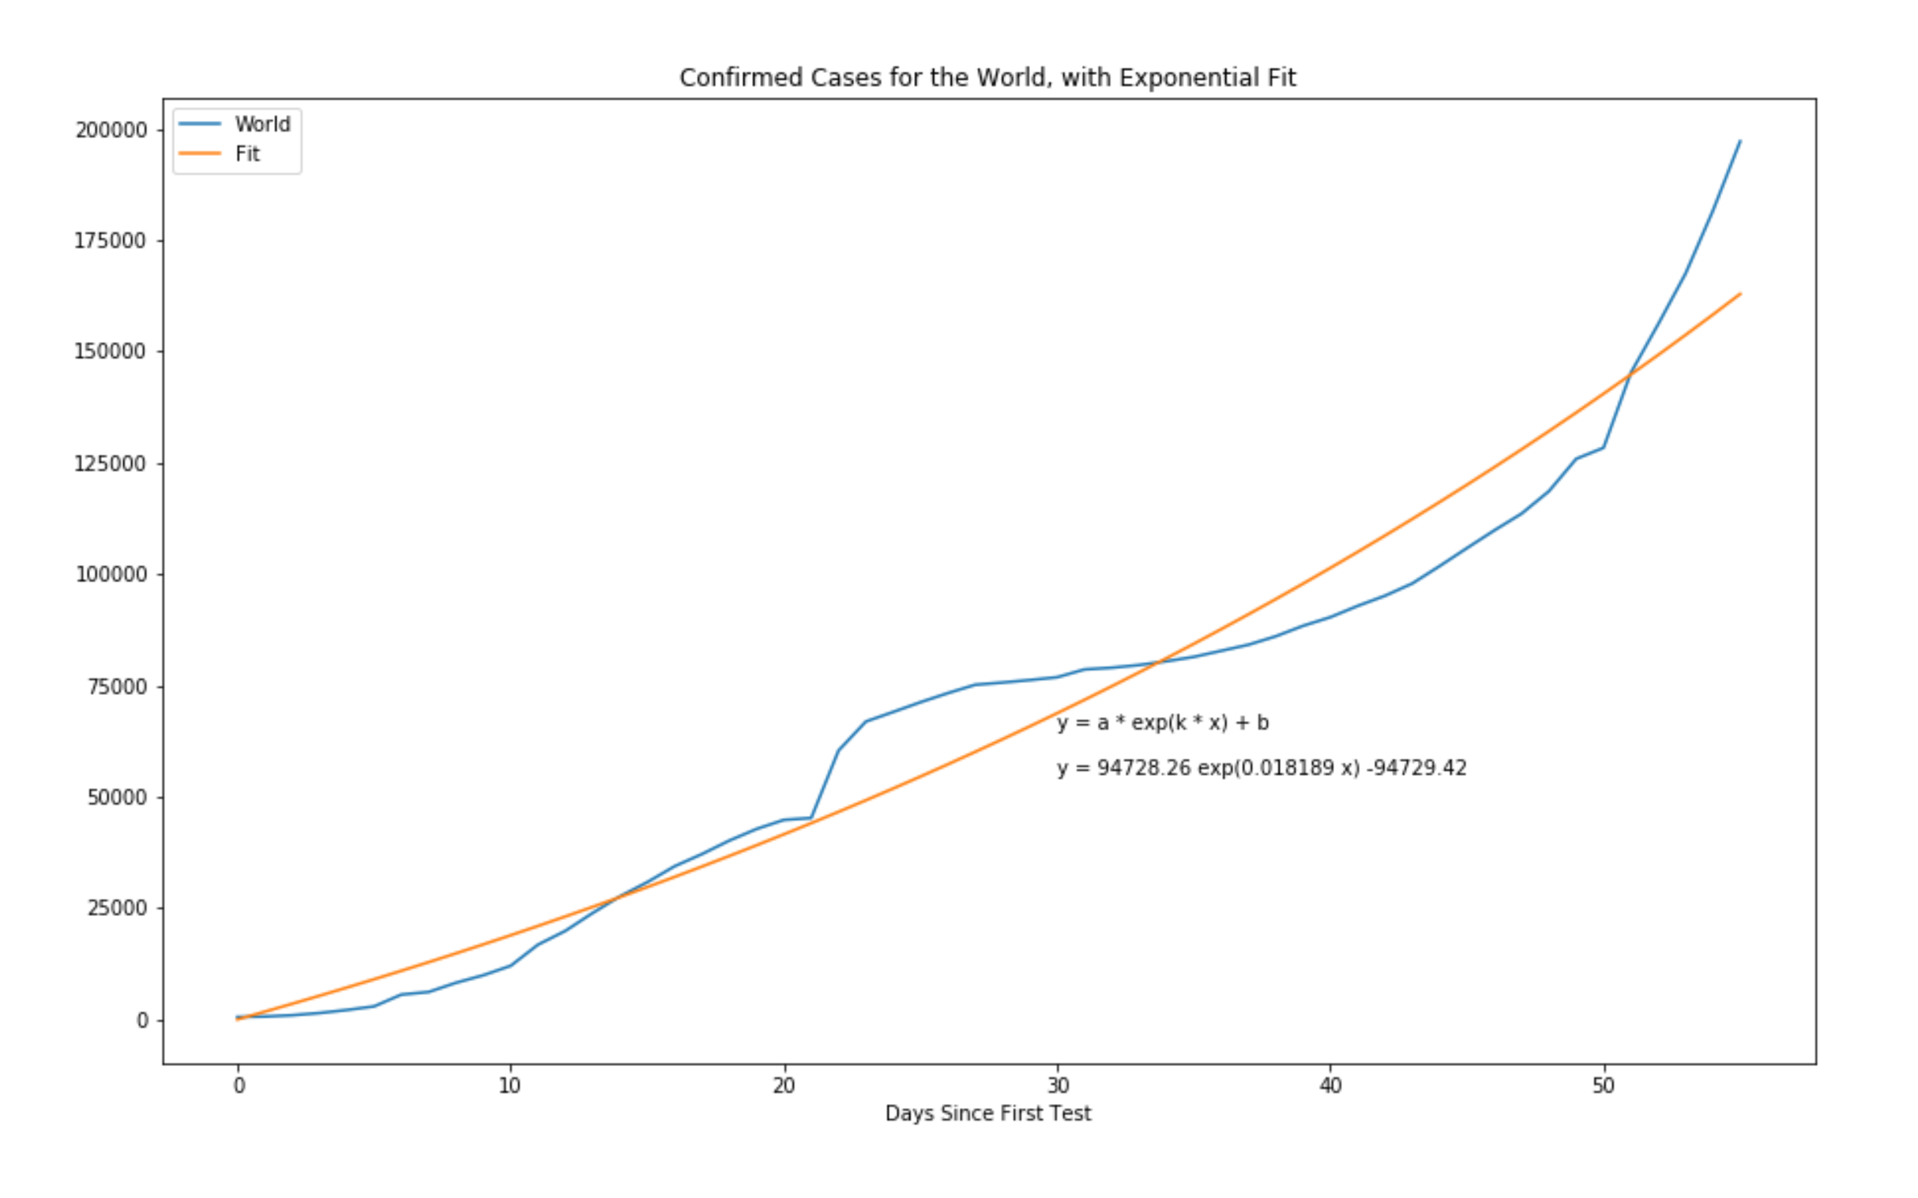
Output 1
Introduction
Project Methodology
Conclusion
Main Question and Project Objectives
Output
Limitation and Recommendation
Notes:
Explain x, y axis
Blue is the plot of actual data set
Orange is for the exponential growth

Slide 7
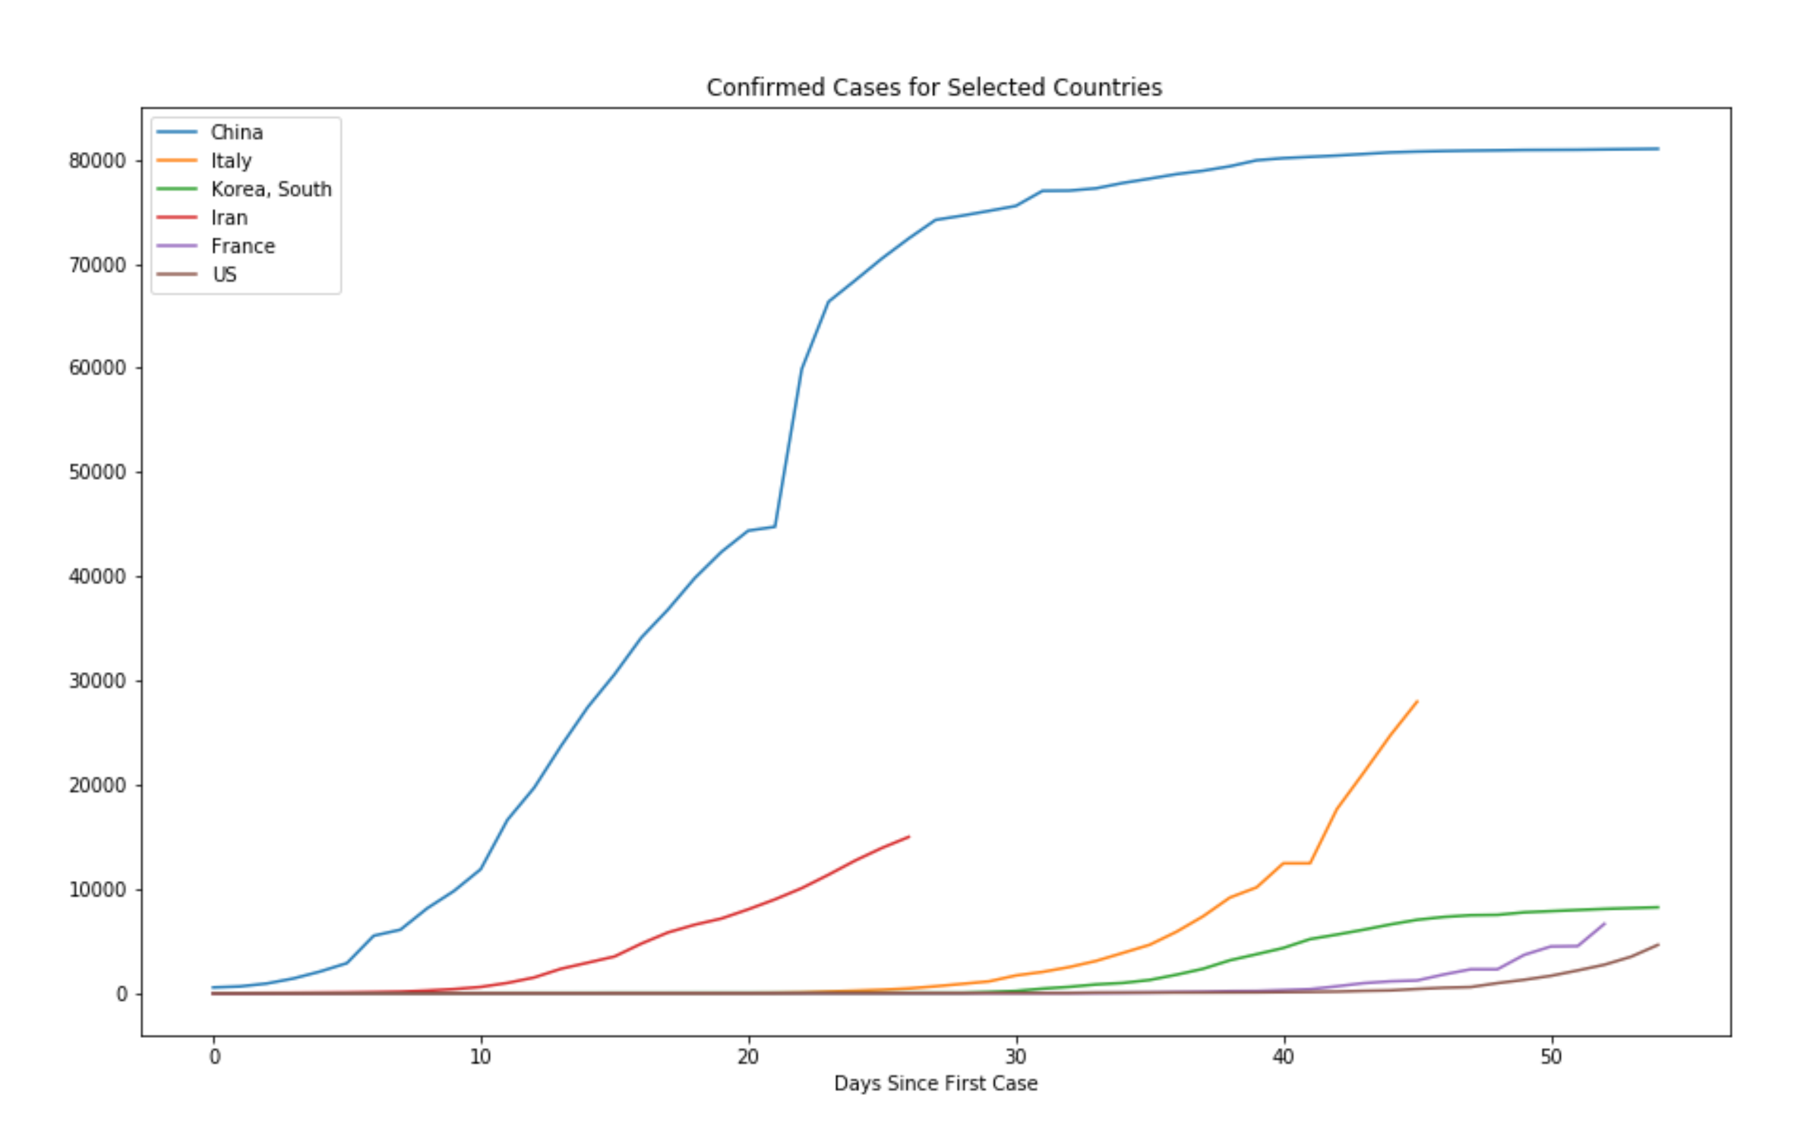
Output 2
Introduction
Project Methodology
Conclusion
Main Question and Project Objectives
Output
Limitation and Recommendation
Notes:
-this is the growth rate for selected countries. China and South Korea started to plateau
-Italy still has steep growth
-

Slide 8
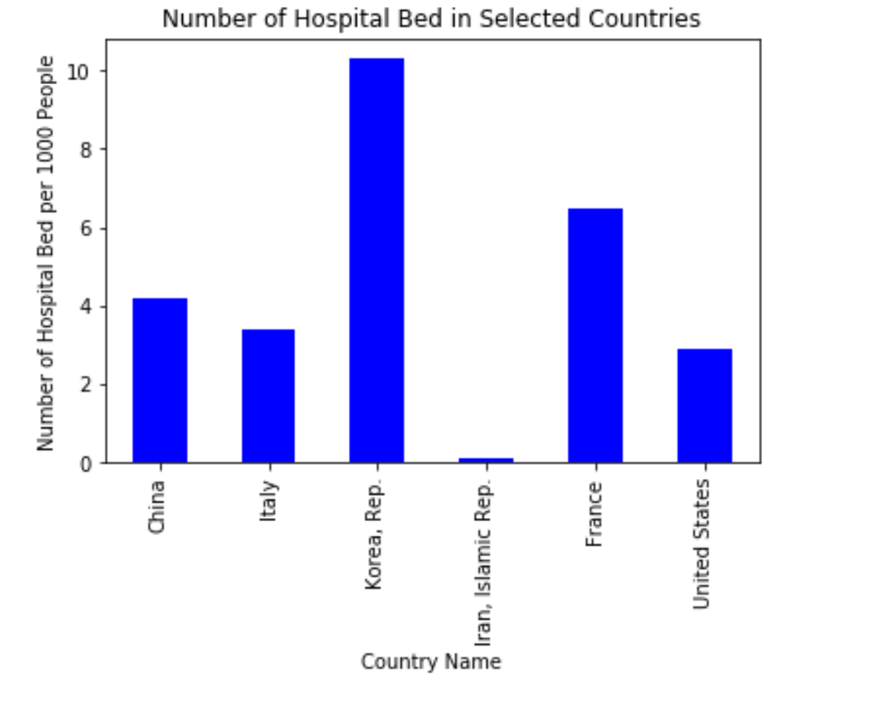
Output 3
Introduction
Project Methodology
Conclusion
Main Question and Project Objectives
Output
Limitation and Recommendation
Notes:
Comparison of number of hospital bed in selected countries

Slide 9
Output 4: box visualization for confirmed cases in us states
Introduction
Project Methodology
Conclusion
Main Question and Project Objectives
Output
Limitation and Recommendation

Slide 10
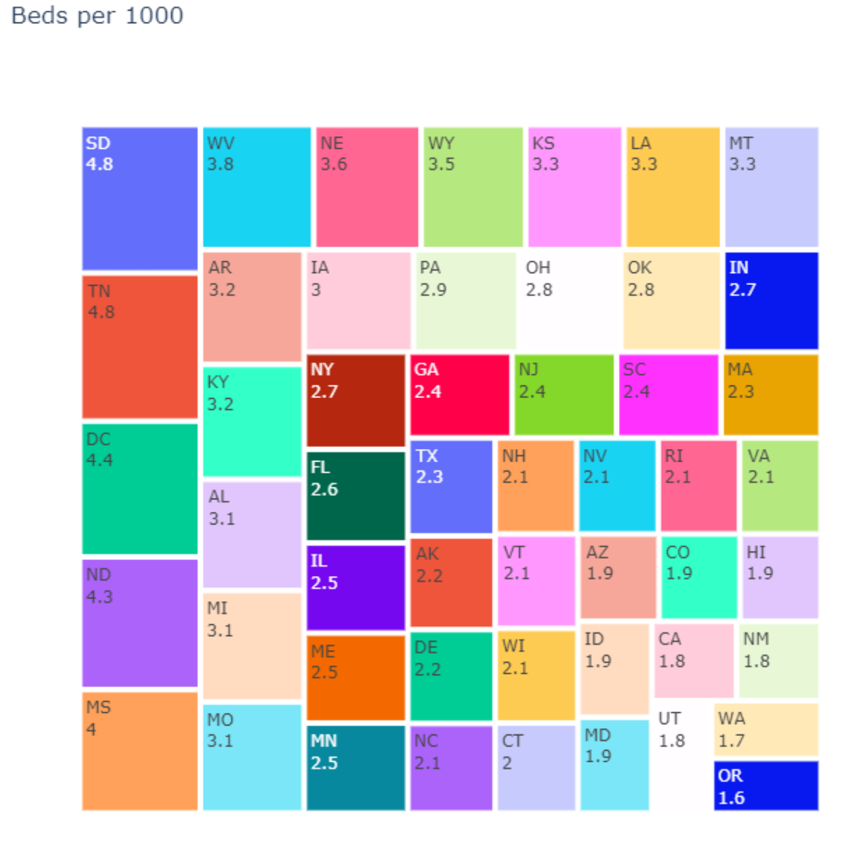
Output 5: box visualization for hospital bed in us states
Introduction
Project Methodology
Conclusion
Main Question and Project Objectives
Output
Limitation and Recommendation

Slide 11
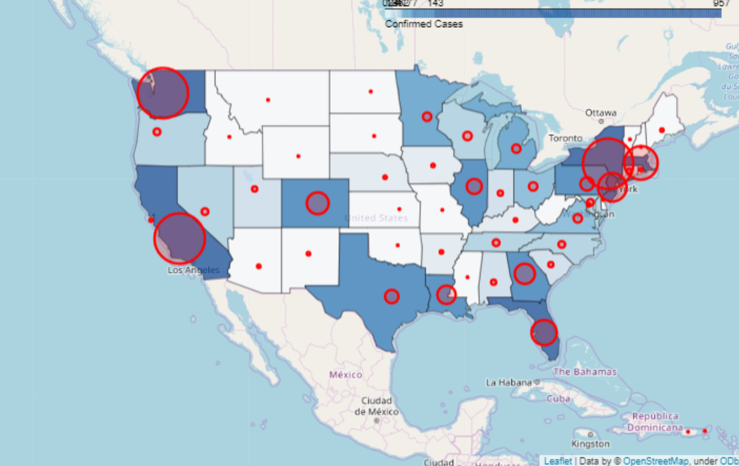
Output 6: Heat Map for Confirmed Cases in US States
Introduction
Project Methodology
Conclusion
Main Question and Project Objectives
Output
Limitation and Recommendation
Notes:
Add legend

Slide 12
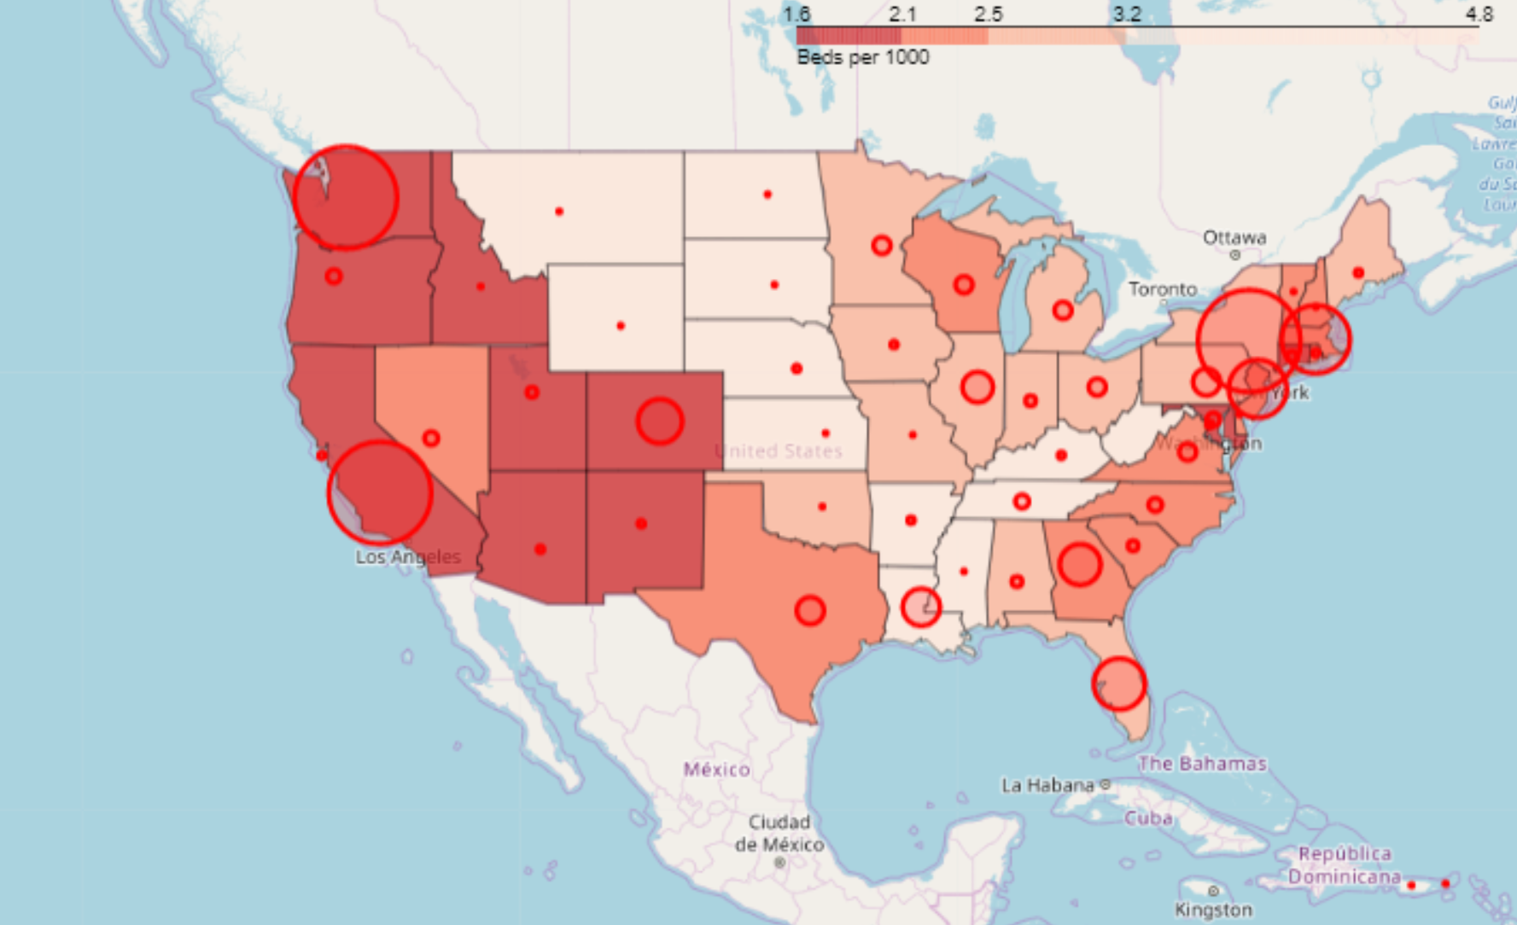
Output 7: Heat Map for Confirmed Cases vs. Hospital Bed in US
Introduction
Project Methodology
Conclusion
Main Question and Project Objectives
Output
Limitation and Recommendation

Slide 13
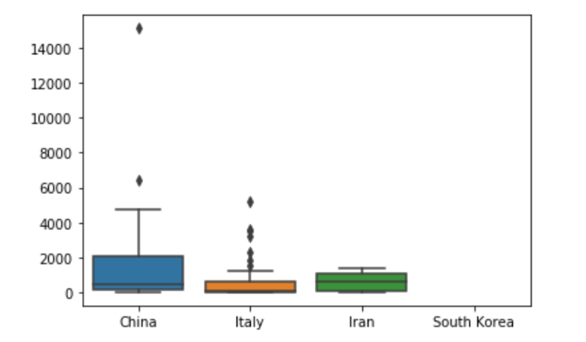
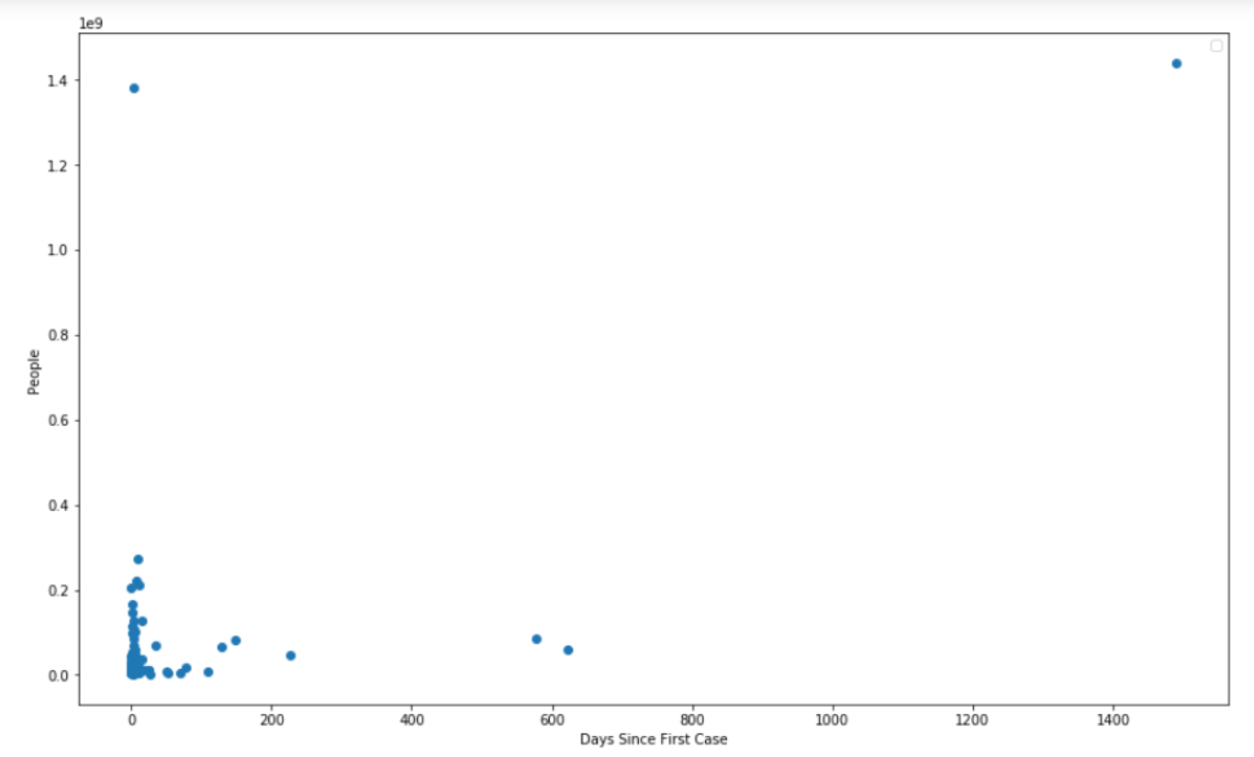
Output 8: statistics for population density vs. number of cases
Introduction
Project Methodology
Conclusion
Main Question and Project Objectives
Output
Limitation and Recommendation

Slide 14
Conclusion
The most vulnerable states in US are
States with(darker number of red) and (higher circle)
Introduction
Project Methodology
Conclusion
Main Question and Project Objectives
Output
Limitation and Recommendation

Slide 15
Limitation and Recommendations
Limitation
Data limitation:
Recommendaetion of future project:
See other health care parameter (number of doctors, health care cost)
See other correlation from other factor (economic growth, hygiene level
Introduction
Project Methodology
Conclusion
Main Question and Project Objectives
Output
Limitation and Recommendation

Slide 16
Any Questions?

Slide 18
introduction
1st Draft
Since the history of the human kind, we have been through several epidemic e.g. Asian Flu :1956-1958, Flu Pandemic or aka Spanish flu : 1918, those were effected millions of life.
With media effort to bring awareness to public, it is also escalate this situation and can cause more panic than it should be, we want to find out what is currently COVID-19 cases situation compare to healthcare provider and facilities that we have? How much will it take to become worst?
In this free and flourish information era, it is the best time for curious minds to get the valid answers without using bias medium.

Slide 19
introduction
2nd draft
Since the development of mankind, the human race has been through several epidemics. For example, the Asian Flu which lasted from 1956 to 1958 and the Flu Pandemic, aka the Spanish Flu which began in 1918. Millions were affected.
With the media’s effort to bring awareness to the public, they are also escalating the situation and are causing more panic than needed. Our goal is to find out how current COVID-19 cases compare to healthcare providers and facilities that are available. How much will it really take for the situation to worsen?
In this era of free and flourishing information, now is the best time for curious minds to get legitimate answers without using a biased medium.

Slide 20
Strategies
Obtain : -
demography of interested area
the data of infection cases, death, recover cases
the data of hospital beds per 1,000 people
Focusing only on
Italy
Topmost effected 5 states in the USA
Texas
Analyst : -
Using linear and exponential functions to show infection rate, recover rate, death rate
Using scatter plots, linear regression and correlation factor to show correlation between population density and infection rate
Using heat map to present the amount of bed per 1,000 people
Using bubble map to present the infection cases per 1,000 people
Conclusion : -
When will it effect Texas ?

Slide 21
Constrains
Too many Homeworks with short period of time not to mention the project???
Not many countries have up-to-date data for hospitals and medical facilities and medical providers.
We'll choose Italy as model (to compare ?) since we can see how it effects them on the media

